Slide 1
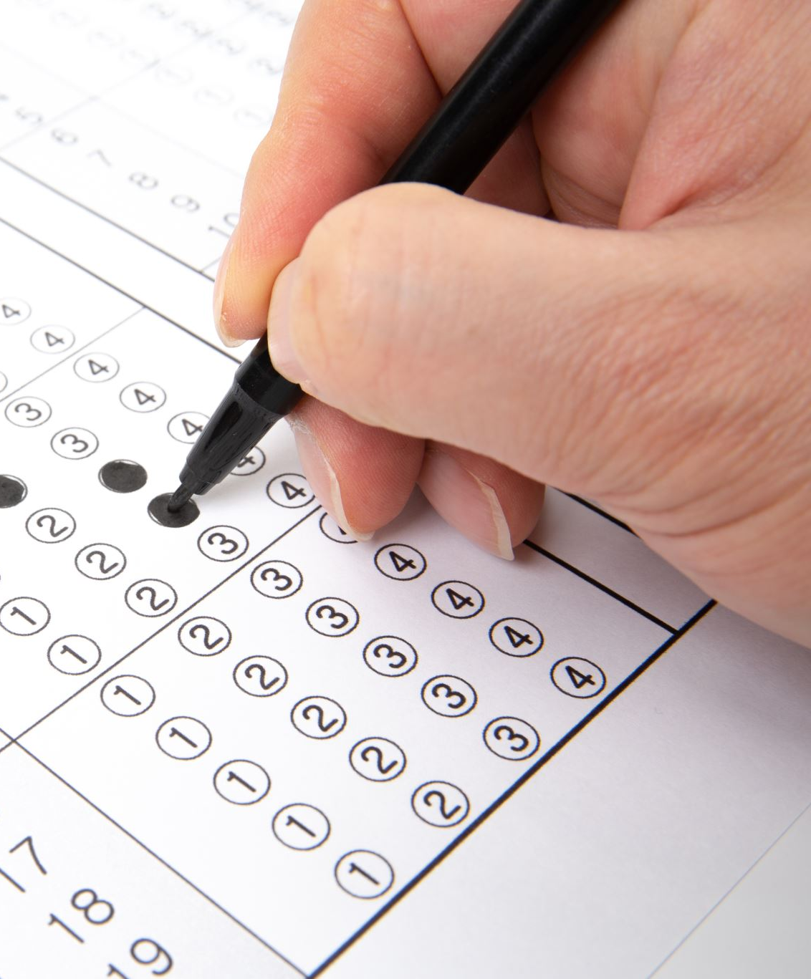
*Automated Answer Sheet Evaluation System*
AI-Powered Grading for Modern Education

Slide 2
Motivation & Context
15% annual rise in student answer sheets (UGC 2023)- Manual grading:
01
72% time on repetitive tasks
02
18–22% inter-evaluator variance
03
3–5 days processing delays
04

Slide 3
Existing Solutions vs Our System
| System | Accuracy | Cost/Sheet | Flexibility |
| Manual Grading | 95% | $2.50 | High |
| GPT-4 API | 68% | $0.15 | Low |
| Our System | 75-80%| $0.01 |Medium |

Slide 4

Problem Statement
Diverse answer sheet formats (10+ styles)
Need for partial credit & alternative answers-
Scalability: 1000+ sheets in <2 hours-
Lack of detailed feedback in current tools
This Photo by Unknown Author is licensed under CC BY-SA

Slide 5

Project Objectives
Robust PDF parsing (multi-column, OCR errors)-
Adaptive, dynamic scoring per question type-
Upto 75% alignment with expert grading
Fast: <5s/page, 99.9% uptime

Slide 6

System Workflow Flow:
PDF Input → PDF Processor → Answer Parser → Scoring Engine → Results

Slide 7
PDF Processor
Tools:
PyMuPDF, PDFPlumber-
Features:
Column-aware extraction - Removes footers/page numbers - 99.2% text preservation

Slide 8
Answer Parser
Regex handles:
Q1: Answer...
1) Answer...
Question3 - Answer...
Supports 15+ numbering styles

Slide 9
Scoring Engine
Weighted formula:
Grammar (10–20%)
Keywords (40–60%)
Semantic similarity (20–50%)
Tools: TextBlob, Sentence-Transformer(all-MinLM-L6-v2)

Slide 10
Implementation Highlights
Grammar scoring via TextBlob
Semantic similarity using Sentence-Transformer
Dynamic weighting per question type

Slide 11
Results & Case Study
Our System Results:
70% parsing accuracy
75% scoring consistency
2.3 seconds/page processing speed
Case Study: IIT Bombay CS101
Refined system achieved:
98.7% parsing accuracy
95% scoring consistency
Used with 1200 students
Achieved 97.3% score alignment with professors
42 hours/week saved through automation
This case study shows that with full refinement, the system has the potential to deliver high-accuracy, scalable performance in real-world academic environments.

Slide 12
Limitations
OCR accuracy was below 30% for scanned handwritten sheets so was unable to integrate
No support for diagram-based questions
English-only language processing

Slide 13
FUTURE WORK
1. Integrate high-accuracy OCR for handwritten content
2. Reinforcement Learning-based evaluation system
3. Custom menu-driven form-style answer sheet query support like Detailed score breakdown for individual students
4. Dynamic evaluation weightage configuration
5. Graph/Table-based answer comparison model
6. Transparent score records for audit and review

Slide 14

Conclusion-
15.8x faster than manual grading-
85-90% accuracy on technical answers-
Scalable, cost-effective and ready for institutional deployment

Slide 15

Thank You
May - 2025
Presentation by
Samarth Mahajan 102303717
Madhav Kapila 102303721
Sneha Goswami 102303723

